Slide 1

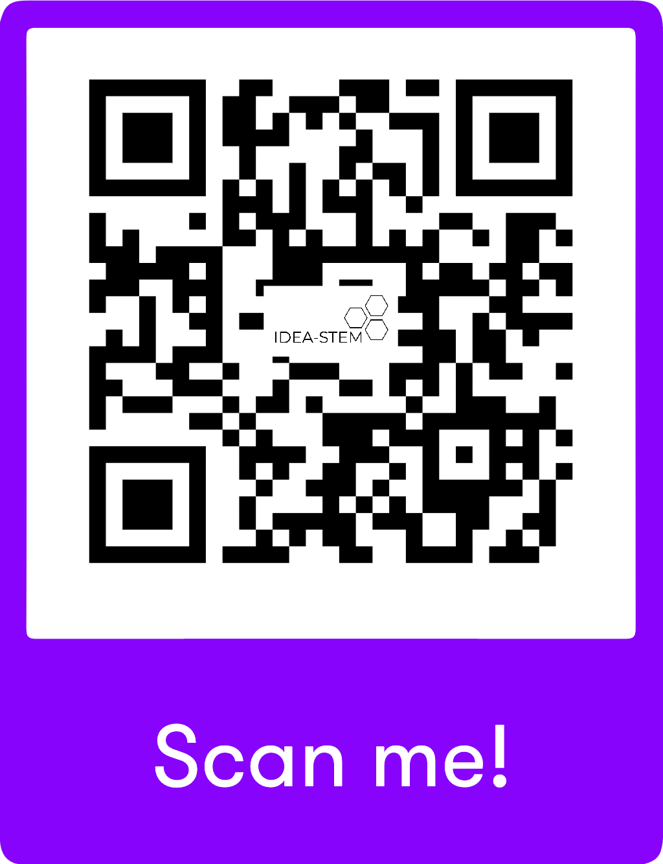
Accessibility, Inclusion and Anti-Ableism in the Oncology Clinic
September 24, 2026
Dr. Mahadeo Sukhai, IDEA-STEM
Chief Operating Officer and Chief Scientific Officer
Canadian Cancer Survivorship Network
Notes:
This project will highlight identified barriers experienced by scientists with disabilities in the natural resources sciences, as well as present solutions to remove and/or prevent these barriers, at the lab/team level, the organization/institution level, and at the discipline level. The knowledge dissemination and training outcomes from this project will lead in the short term to improvements in equity within natural resources sciences research environments, by facilitating changes to professional practice that allow for the consideration of the unique experiences and needs of colleagues with disabilities. In the short to medium term, inclusion will be enhanced through proactive design of working environments in the natural resources sciences domain to be accessible and anti-ableist; this will happen through policy and governance evolution as well as through the implementation of “accessible by design” workspace practices. Over time, this will lead to improved diversity by increased representation of scientists with disabilities within the space.

Slide 2
Introducing Myself
Favourite colour is blue, science fiction fan, love to cook, love to read, absolutely love spend time with my daughter, second language is Spanish, I can count to 10 in 5 languages, I love (warm) beaches, the sound of oceans is calming to me…
Son, brother, cousin, friend, husband, dad
Scientist, educator, researcher, executive
Caregiver and supporter to a brain tumor survivor
I am cis-male, neurodivergent, person who lives with a disability
Born in Guyana, South America
South Asian, Indo-Caribbean ancestry, first generation settler, newcomer
Born blind, corrective surgery – now live with physiological low vision and neurological visual processing differences

Slide 3
Positionality
My Lived, Living and Professional Experience
Caregiver
Parent
IDEA Professional
Healthcare Researcher
Educator
Accessibility in STEM and Healthcare

Slide 4
IDEA-STEM Vision
IDEA-STEM positively contributes to a world in which participating in and benefiting from employment, education and healthcare, particularly through science, technology, engineering, mathematics (STEM), is a universal human right, grounded in disability justice, inclusive of persons with disabilities.
We envision systems transformed by the leadership, knowledge and creativity of disabled, neurodivergent, mad and chronically ill persons.
Notes:
Mahadeo

Slide 5
IDEA-STEM Strategy
Our Mission
Science
Carrying out Inclusive Science
Teaching Science Inclusively
Strategy
Research & Evaluation
Knowledge
Inclusive Teams
Accessibility Strategy
Learning & Development
Standards
Inclusive Science Literacy

Slide 6
Intersections Among My Personal and Professional Identities
Disabled Person
Cancer Geneticist
Accessibility Thought Leader
Caregiver

Slide 7
Consent To Share
Verbal consent provided, September 21, 2026

Slide 8
Three Stories from my Cancer Survivorship and Caregiving Journey
Nurse to my wife: “But your hearing loss is because of the brain tumor, isn’t it?”

Slide 9
Three Stories from my Cancer Survivorship and Caregiving Journey
Patient accessibility advocate, in response to a request to discuss accessibility accommodations: “Here’s a list of hotels nearby.”

Slide 10
Three Stories from my Cancer Survivorship and Caregiving Journey
Oncologist to Patient: “Your blindness was collateral damage. Be grateful – the tumor could have killed you.”

Slide 11
Bonus Story
Oncologist to a friend who is a cancer patient: “We’re not really sure how to handle your treatment, given your disability.”

Slide 12
Perception
Cancer is primary.
Disability is both secondary and irrelevant to cancer treatment and survivorship.

Slide 13
“The Largest Minority Group in Canada”
27% of Canadians aged 15-64 identify as persons with disabilities (CSD, 2022)
*This does not include persons living with chronic health conditions who do not identify as persons with disabilities
Notes:
This project will highlight identified barriers experienced by scientists with disabilities in the natural resources sciences, as well as present solutions to remove and/or prevent these barriers, at the lab/team level, the organization/institution level, and at the discipline level. The knowledge dissemination and training outcomes from this project will lead in the short term to improvements in equity within natural resources sciences research environments, by facilitating changes to professional practice that allow for the consideration of the unique experiences and needs of colleagues with disabilities. In the short to medium term, inclusion will be enhanced through proactive design of working environments in the natural resources sciences domain to be accessible and anti-ableist; this will happen through policy and governance evolution as well as through the implementation of “accessible by design” workspace practices. Over time, this will lead to improved diversity by increased representation of scientists with disabilities within the space.

Slide 14
One Perception, Three Realities
Cancer Is Disabling
Disability, Cancer Patients and Caregivers
Intersectional Incidence

Slide 15
Reality #1
42-45% of Canadians - lifetime incidence of cancer
27% of Canadians live with disabilities

Slide 16
Reality #2
In any given year, 1 million Canadians are living with cancer, and 1 million Canadians are caregivers and supporters to their person
In any given year, up to 540,000 Canadians with disabilities are navigating cancer survivorship and caregiving journeys

Slide 17
Reality #3
Cancer (and cancer treatment) are functionally disabling for many, situationally, temporarily or even permanently
US Job Accommodation Network: Cancer is listed as a disability

Slide 18
Implications
Accessibility barriers abound
  Access to information
  Physical access
  Navigation of cancer diagnosis, treatment and survivorship pathways
  Access to and quality of care
  Medical
“Getting it right is far better than shortcuts in the name of efficiency”

Slide 19
Why Aren’t We Talking More About Accessibility and Oncology in the Same Breath?
Notes:
This project will highlight identified barriers experienced by scientists with disabilities in the natural resources sciences, as well as present solutions to remove and/or prevent these barriers, at the lab/team level, the organization/institution level, and at the discipline level. The knowledge dissemination and training outcomes from this project will lead in the short term to improvements in equity within natural resources sciences research environments, by facilitating changes to professional practice that allow for the consideration of the unique experiences and needs of colleagues with disabilities. In the short to medium term, inclusion will be enhanced through proactive design of working environments in the natural resources sciences domain to be accessible and anti-ableist; this will happen through policy and governance evolution as well as through the implementation of “accessible by design” workspace practices. Over time, this will lead to improved diversity by increased representation of scientists with disabilities within the space.

Slide 20

Accessibility
Accessibility is the design (and implementation!) of systems, policies, processes, ways of interacting with each other, and environments to ensure that all persons have equal access to a given space.
• Not only “people with disabilities”.
• Accessibility is “an umbrella term for all aspects which influence a person’s ability to function within an environment.”
• In this context, Accessibility is different than Availability, although often these terms get conflated

Slide 21
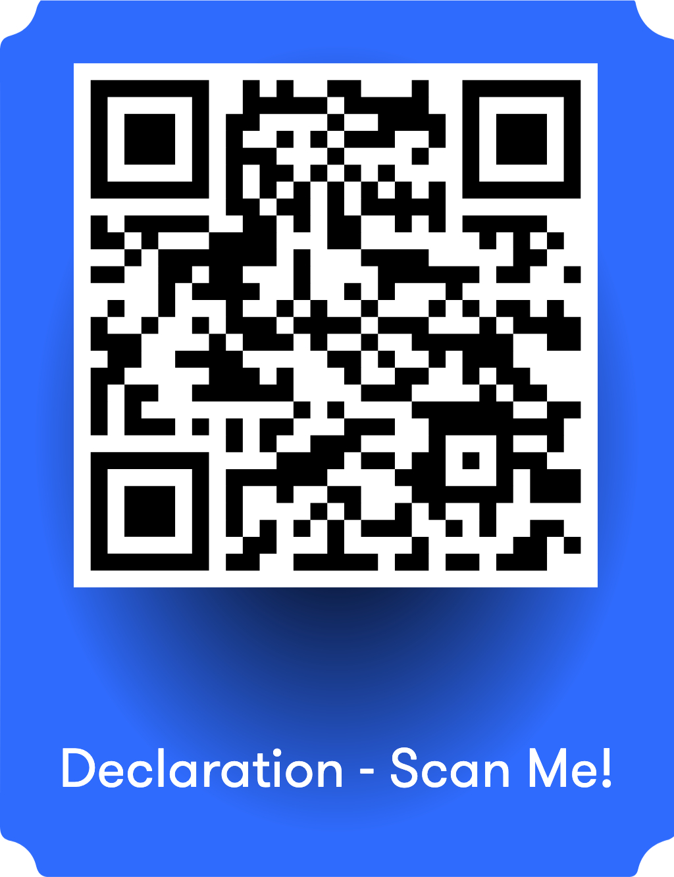
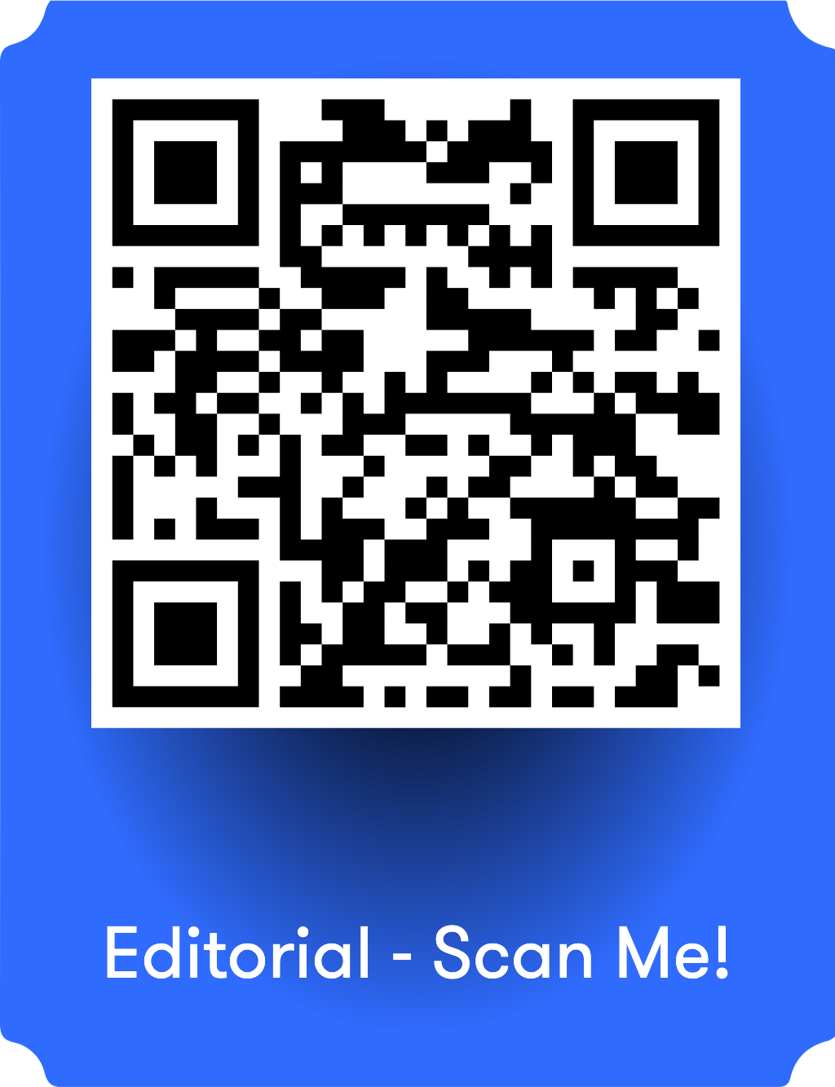
Science as a Universal Human Right
Notes:
Mahadeo

Slide 22
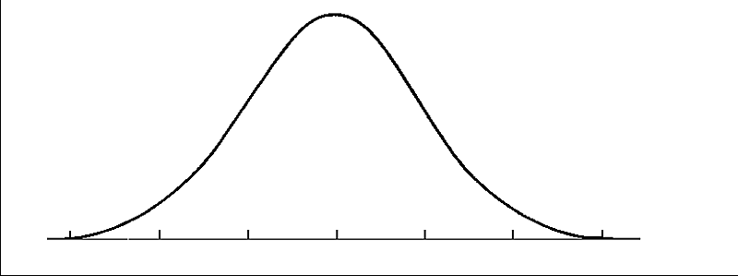
The “Average” Person as the “Ideal” Person
Based on the statistical notion that a human population can be modeled as a normal distribution, and that an accurate statistical model of the population can be derived from a “vital few” close to the centre of the distribution
Persons (or data points) on the “edges” of the distribution (“minority populations”) can be excluded from analysis as outliers and not representative of the whole

Slide 23
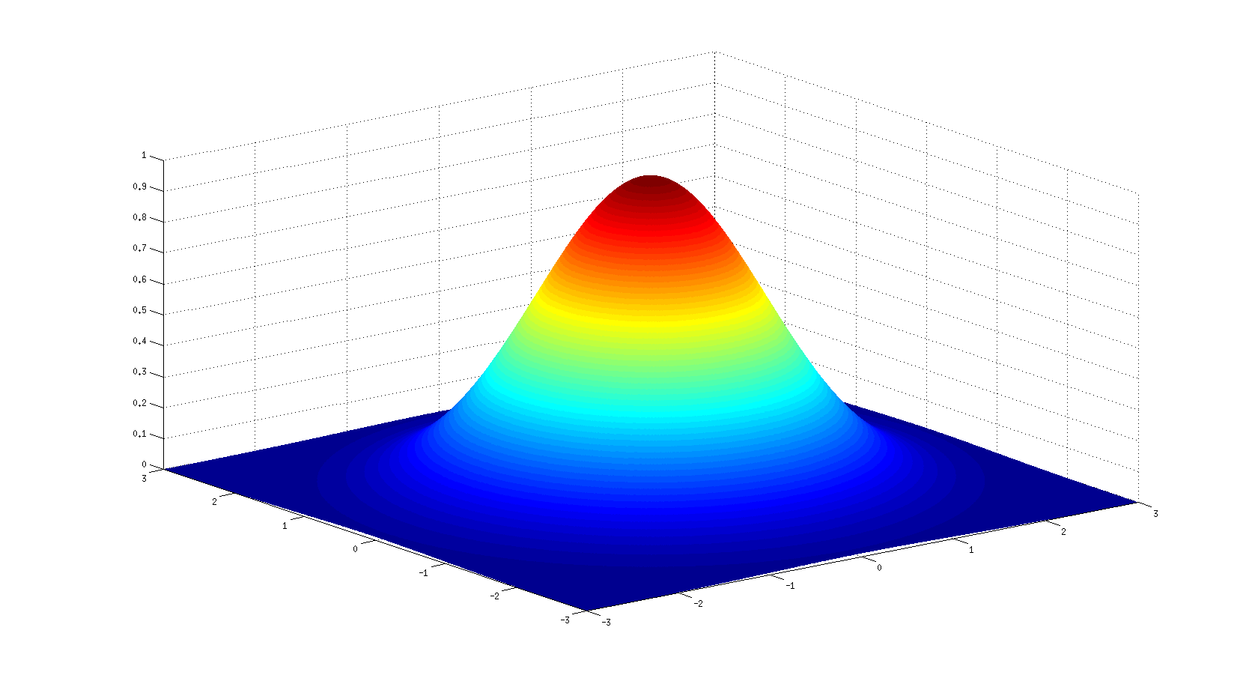
The “Average Person” is at the Top of the Hill
Notes:
The way things are – barriers
The way things ought to be - solutions
Put in solution – the goal is to design solutions for the people who fit on the plain not on the hill
Upward facing solution from the plains up
“modeling single
If show up on the plains they won’t show up on the hill, those in the middle of the bell curve will show up on the plains
If you think about hill as the privilege bvantage point – the people on top of hill buildt for those on the hill
But on the plains building for people on the planins it builds for those on the top of the hill
Illustrates privilege
The hill is colour coded like a heat map
Our message is this image – think of anything you are designing, think about this metaphor

Slide 24
Disability and Accessibility Are Far-Reaching
Situational Lived Experience
People with Temporary Disabilities
People with Permanent Disabuilities
People with Permanent [Significant, Apparent] Disabilities

Slide 25
Principles of Equivalency in Access
Access
Equivalent Accessibility
Equivalent User Pathways
Equivalent Achievement

Slide 26
Lessons Learned…
From interacting with the healthcare system
From working within the healthcare system

Slide 27
Interacting with Healthcare
Interaction with Healthcare
Treat condition, not person
Common cause
"Watch and wait"
"I can't do anything [more] for you"
Knowledge flows upward
"Accessible" accommodations

Slide 28
Working within Healthcare
Working within Healthcare
Pyramid
Professional experience rules
”Myth of perfection"
Experts solve things
Patients not partners
”Engagement is new”

Slide 29
A (Brief) History of How We Frame Disability (in the Western World)
1700s-1800s: Affliction
1800s-1900s: Handicap
1900s: Special needs
1900s: Different Ability
1900s-2000s: Disability
Future: Human Phenotype Variation

Slide 30
Conceptualization of Disability in Oncology and Healthcare
Health Outcome
Demographic Identity

Slide 31
What is Disability, really?
More an identity and demographic for someone born with the lived experience
More a health outcome for someone who acquires disability as they age

Slide 32
Power Dynamics and Personhood in Oncology and Research
Notes:
This project will highlight identified barriers experienced by scientists with disabilities in the natural resources sciences, as well as present solutions to remove and/or prevent these barriers, at the lab/team level, the organization/institution level, and at the discipline level. The knowledge dissemination and training outcomes from this project will lead in the short term to improvements in equity within natural resources sciences research environments, by facilitating changes to professional practice that allow for the consideration of the unique experiences and needs of colleagues with disabilities. In the short to medium term, inclusion will be enhanced through proactive design of working environments in the natural resources sciences domain to be accessible and anti-ableist; this will happen through policy and governance evolution as well as through the implementation of “accessible by design” workspace practices. Over time, this will lead to improved diversity by increased representation of scientists with disabilities within the space.

Slide 33
Traditional Power Dynamics in Biomedical and Health Science
Lab Staff
Admin Staff
Patient & Caregiver
Clinical Staff
Physician/Scientist

Slide 34
Traditional Power Dynamics in Biomedical and Health Science
On a Single Team
In a Grant
Doctoral
Master’s
Undergrad
Postdoc
PI
Co-Applicant
Collaborator
Trainee
Co-PI
NPA

Slide 35
Traditional Power Dynamics in Biomedical and Health Science
On Translational Teams
In Research
Clinical Staff
Scientific Staff
Trainees
Scientists
Clinicians
Knowledge Users
Research Participants
Knowledge Mobilizers
Knowledge Generators

Slide 36
Personal Barriers ➔ Systemic Barriers
Notes:
This project will highlight identified barriers experienced by scientists with disabilities in the natural resources sciences, as well as present solutions to remove and/or prevent these barriers, at the lab/team level, the organization/institution level, and at the discipline level. The knowledge dissemination and training outcomes from this project will lead in the short term to improvements in equity within natural resources sciences research environments, by facilitating changes to professional practice that allow for the consideration of the unique experiences and needs of colleagues with disabilities. In the short to medium term, inclusion will be enhanced through proactive design of working environments in the natural resources sciences domain to be accessible and anti-ableist; this will happen through policy and governance evolution as well as through the implementation of “accessible by design” workspace practices. Over time, this will lead to improved diversity by increased representation of scientists with disabilities within the space.

Slide 37
How We Identify and Remove Barriers Today
Encounter a Barrier
What kind of barrier?
Ask for Help
Who to go to?
(Co-) Develop a Solution
Personalized outcome
“This will work for me”
Hoe to ask?
“How does it impact my participation?”

Slide 38
Phenotype and Experience: How We Conceive of Barriers Today
Intrinsic Factors / Person Centered
Extrinsic Factors / Systemic

Slide 39
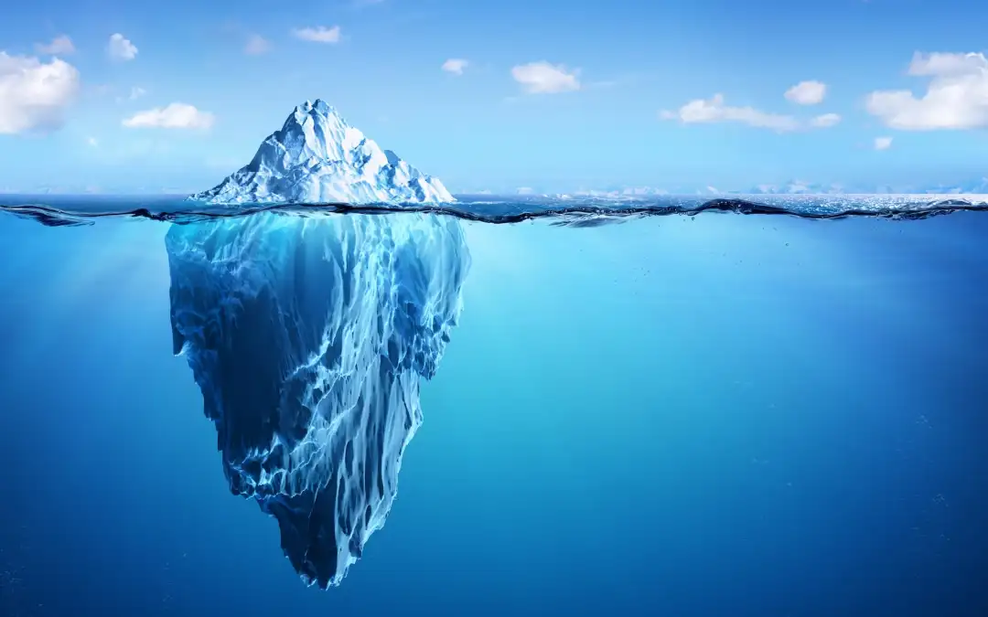
(Re)Conceiving Barriers
Person-Centered Barrier
Systemic Barrier

Slide 40
How Healthcare Works
Diagnose
Treat/Cure
Prevent

Slide 41
How We Address Barriers
Identify
Remove
Prevent

Slide 42
Ableism ➔ Barriers
Notes:
This project will highlight identified barriers experienced by scientists with disabilities in the natural resources sciences, as well as present solutions to remove and/or prevent these barriers, at the lab/team level, the organization/institution level, and at the discipline level. The knowledge dissemination and training outcomes from this project will lead in the short term to improvements in equity within natural resources sciences research environments, by facilitating changes to professional practice that allow for the consideration of the unique experiences and needs of colleagues with disabilities. In the short to medium term, inclusion will be enhanced through proactive design of working environments in the natural resources sciences domain to be accessible and anti-ableist; this will happen through policy and governance evolution as well as through the implementation of “accessible by design” workspace practices. Over time, this will lead to improved diversity by increased representation of scientists with disabilities within the space.

Slide 43
Ableism and Disableism
Ableism
  The centering of having ability in a person’s feelings, thinking and/or behaviour.
Disableism
  The marginalization of disability in one’s feelings, thinking and/or behaviour.

Slide 44
Ableism and Disableism (2)
Disableism
Ableism

Slide 45
Ableism, Disableism and Discriminatory Behaviour
Disableism: Overt
Ableism: Covert

Slide 46
Does the Destination Matter More Than The Journey?
74% of adults believe that outcome matters more than process
Physics lesson: Distance vs. Displacement
The Good: It doesn’t matter how something gets done, as long as it gets done
The Bad: This perspective may not foster attention to quality of the user experience
  “You can do it, who cares how hard it is?”
Notes:
Mahadeo

Slide 47
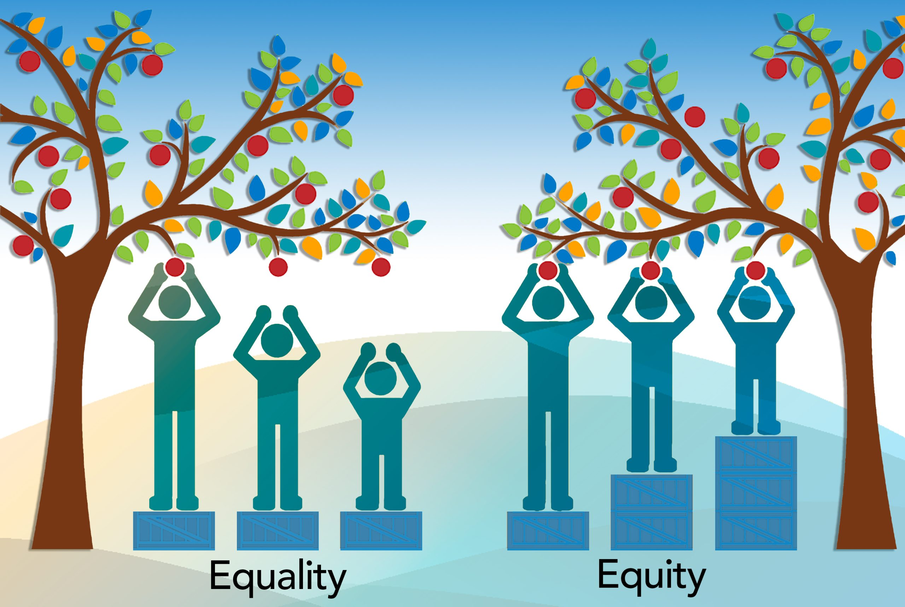
How We Think About Fairness Matters
73% of adults believe that “fairness” is equal treatment (“equality”) as opposed to equal opportunity to achieve an outcome (“equity”)
In small, homogenous communities, equity functionally “collapses down” to equality
Notes:
Mahadeo

Slide 48
Personal vs. Systemic Ableism/Disableism
Personal – centered on the individual
  Expressed and reflected in attitudes (overt and covert)
  Disconnect between feelings and thoughts/behaviours
Systemic – centered on policies, practices, frameworks

Slide 49
Assumptions of Ableism
We make assumptions about who ”belongs” within a given space, or how rules apply to a group of people
We make assumptions about “use cases” in every situation we think about
These assumptions underpin how we develop policy, practice, guidance, frameworks…
BUT they are likely not to be conscious assumptions

Slide 50
Truism
“The system’s not broken”
A system designed to be exclusive of persons with disabilities cannot be broken if it’s doing the very thing it’s set up to do

Slide 51
From Barriers to Systemic Ableism
Person-Centered Barrier
Systemic Barrier
Ableism

Slide 52
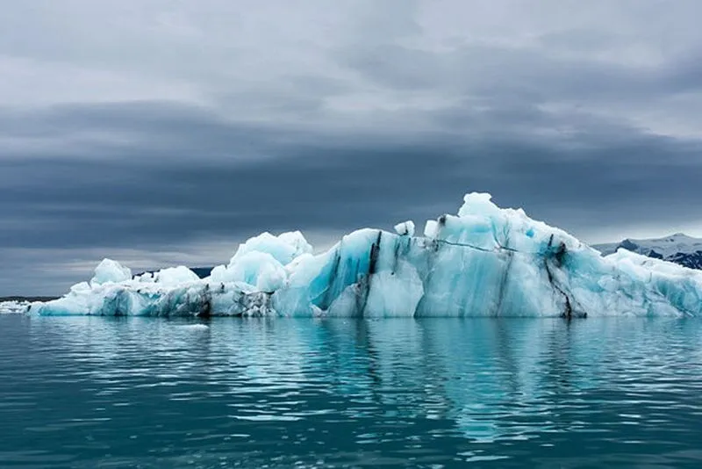

How do we get from there to here?

Slide 53
Recognizing Ableism
…In oneself is very hard – need to be self-reflective and self-critical
…In others is easier – but we don’t call it ”ableism”
…In systems, policies and practices is hardest…especially if we live within those systems
“The importance of asking WHY”

Slide 54
Not Being Ableist vs. Anti-Ableism
“Not Ableist”
  Bystander
  Passive observer
  Inaction
Anti-Ableism
  Active calling out and calling in

Slide 55
Countering Ableism
Allyship
Universal Design
Inclusive Design
Equitable Design
“If you’re not part of the solution…”

Slide 56
Universal Design
A set of environmental solutions designed to maximize inclusion of the greatest number of persons within the [workplace] environment
NOT “one size fits all” (although that’s a common misperception)

Slide 57
The 3 A’s
Anti-Ableist Clinics
Accessible by Design Clinics
Accommodations @ The Clinic

Slide 58
Bias and Ableism
Notes:
This project will highlight identified barriers experienced by scientists with disabilities in the natural resources sciences, as well as present solutions to remove and/or prevent these barriers, at the lab/team level, the organization/institution level, and at the discipline level. The knowledge dissemination and training outcomes from this project will lead in the short term to improvements in equity within natural resources sciences research environments, by facilitating changes to professional practice that allow for the consideration of the unique experiences and needs of colleagues with disabilities. In the short to medium term, inclusion will be enhanced through proactive design of working environments in the natural resources sciences domain to be accessible and anti-ableist; this will happen through policy and governance evolution as well as through the implementation of “accessible by design” workspace practices. Over time, this will lead to improved diversity by increased representation of scientists with disabilities within the space.

Slide 59

Homo categoricus
Thinking in categories helps us to:
Form social structure: identify as part of an established social group (i.e. projecting the appearance of an age group younger than self)
Leap beyond available information: conceive a mental image of a person with specific attributes whom you have never met or known about (e.g. a Black, Muslim, French, 70 year old professor)
Helps us to process complex information quickly
Keeps us safe
Helps us to form mental images of complex ideas
But also has consequences…

Slide 60
Stereotyping
A stereotype is a widely held social belief or category about a group of people, which is oversimplified and minimizes the diversity of attributes/experiences within the category
Even though we all stereotype, not everyone has the same probability of being stereotyped by others
You are more likely to be stereotyped if you are not a part of the dominant group, or adopt behaviours of the dominant culture
People with disabilities often stereotyped in STEM

Slide 61
What Is Unconscious Bias?
Unconscious biases are the stereotypes held about groups of people from outside a person’s conscious awareness
Arise from our tendency to categorize or stereotype
Exist deep within our minds
Ingrained attitudes that can be in conflict with our conscious beliefs but still affect our actions, decisions and understanding of the world in a subconscious way
This is why we feel uncomfortable when confronted about our biases
We all have unconscious biases

Slide 62
10 Types of Unconscious
Bias (1)
Affinity bias (gravitating toward people who look like us)
Appearance bias (snap judgement based on what someone looks like – e.g., beauty, weight, height biases)
Confirmation bias (interpreting new information to confirm what you’re already thinking)
Attribution bias (correlates someone’s actions with unrelated characteristics)
Ability bias (unintentional associations based on someone’s ability or disability)

Slide 63
10 Types of Unconscious
Bias (2)
Gender bias (unintentional associations based on a person’s gender)
Age bias (unintentional associations based on a person’s age)
Authority bias (placing more weight on the opinion or idea of an authority figure)
Halo Effect (using an overall positive impression of someone to influence other judgements of their character)
Horn effect (using an overall negative impression of someone to influence other judgements of their character)

Slide 64
Unconscious Bias
Leads to “-isms”
Ableism
Ageism (and reverse ageism)
Caste-ism
Classism
Colourism
Racism
Sexism
“Other is different. Different is bad”

Slide 65
“-Ism” and “Exceptionalism”
Ableism vs. “ability exceptionalism”
“Us” vs. “Them” behaviours
“Not ableist” is different from “anti-ableist”
  Everyone needs to be part of the solution
Situational nature of “-ism” behaviours
Intersectional nature of “-ism” behaviours
  A blind person saying “I don’t see colour”
Everyone expresses ableism in their life, many people also express anti-ableism in their life

Slide 66
Unconscious Bias and Disability
All disabilities are visible: young person using priority seating on a bus, not using a microphone at a lecture or an in-person science activity
Persons with disabilities aren’t well-educated, and this is why they have low employment
Persons with disabilities always need someone to help them
If I can’t see, I also can’t hear
If my speech is unclear or I stutter, I have less cognitive capacity
Persons with disabilities don’t understand [and don’t do] science or research
Persons with disabilities can’t use technology
Persons with disabilities don’t understand the science behind public health measures for covid
Persons with disabilities don’t understand climate change

Slide 67
What does Unconscious Bias “look” like?
Persons with disabilities are not often used as models in science media or in marketing communications (other than disability related stories/products)
Us vs Them attitudes “I am a good person and I will help them”
design (layout for example of an office, of a print communication, of a workshop or activity, of an exhibit, of marketing practices)
Mentorship and/or Sponsorship of a student, volunteer or employee without a disability
Expectation of accommodation requests rather than universal design, requests for alternative format print materials rather than having multiple formats or an accessible format available
Employee not aware of where to find assistive technology at a museum, or that persons who need support persons may pay reduced admission etc.
Science activities or exhibits designed with equipment that can only be used with one sense

Slide 68
What does Unconscious Bias
“look” like?
Attitudes: Self Talk
Attitudes shaping what we communicate, how we communicate, the tools we use to communicate
Shapes expectations in how our audience interacts with information – and how we interact with each other
Generally expressed as “helping” behaviour that benefits the dominant group
Exclusionary behaviour (discrimination)
Subtle discrimination in form of microaggressions

Slide 69
Attitudes: “-ism” Blindness
“-ism” Blindness
  “I don’t see [skin colour, ability, gender…]”
  On the surface, the right thing to do
  An attempt to not be biased by a person’s lived experience
  Treats everyone the same
  Does not take into account lived experience

Slide 70
Attitudes: “-ism” Awareness
“-ism” Awareness
  “I recognize the totality of your lived experience”
  On the surface, the harder thing to do
  A recognition that it’s not possible to take a person out of context
  Need to check biases

Slide 71
The Anti-Bias Framework
Every human has biases
Saying “I’m not biased” is therefore patently false, even if we call out and acknowledge the biases that we have (or ”had”)
It is impossible for us to declare that we are unbiased in our work
But it is possible to be “Anti-Biased”
  I acknowledge my biases
  I actively work to counter them, through reflection, learning and action

Slide 72
What to do about bias?
Ask “why” 5 times when challenging a bias
Make hidden biases explicit
Expect change to be slow, work to stay in game for the long haul
Help others understand unconscious bias is normal: share your own biases
Define expectations in relationship with your colleagues
Normalize feeling uncomfortable
Practice Self Care: Expect a lot of resistance from people when addressing unconscious biases

Slide 73
Recognizing Bias in Oneself
Acknowledge that everyone has biases
  Educate oneself
  Self-reflect
Let others challenge your assumptions
Be open to feedback
Embrace diverse perspectives

Slide 74
Countering Bias in Group Settings
Be aware of your own biases
Take time to make decisions as a group – rapid decision making is more prone to be biased
Monitor group behaviour
Pay attention to intersectional identity biases
Have a “team contract” – ground rules for behaviour
Avoid assumptions or going on your gut
Speak out if you notice bias
Apologize if you get it wrong

Slide 75
A Change Roadmap
Notes:
This project will highlight identified barriers experienced by scientists with disabilities in the natural resources sciences, as well as present solutions to remove and/or prevent these barriers, at the lab/team level, the organization/institution level, and at the discipline level. The knowledge dissemination and training outcomes from this project will lead in the short term to improvements in equity within natural resources sciences research environments, by facilitating changes to professional practice that allow for the consideration of the unique experiences and needs of colleagues with disabilities. In the short to medium term, inclusion will be enhanced through proactive design of working environments in the natural resources sciences domain to be accessible and anti-ableist; this will happen through policy and governance evolution as well as through the implementation of “accessible by design” workspace practices. Over time, this will lead to improved diversity by increased representation of scientists with disabilities within the space.

Slide 76
Historical Framing of Accessibility
Accessibility is asked for
Accessibility is something needed by a distinct minority
Accessibility is an add-on
Accessibility needs have to be proven by the user to be acted on or implemented
Enshrinement of these principles in the human rights case law, and in accessibility policies and practices in education and employment (via “duty to accommodate”)

Slide 77
What Accessibility by Design “Looks and Feels” Like
Proactive approaches, not reactive
Accessibility benefits everyone
Accessibility is embedded at the design phase
No proof required – no disclosure required
Established by ensuring that accessibility is rooted in all policies and practices that define the space, creating a framework to be enacted always and for everyone

Slide 78
Framing Anti-Ableism and Accessibility by Design in Oncology Clinics
Accessible by Design Oncology Clinics
Accessible formats
Accessible environments
Frames of Reference
Allyship
Anti-Ableist Approaches

Slide 79
Changing the Interaction with Healthcare
Treat the person, not the condition
Balancing emotional well-being with physical risk
Disability lived experience not always related to other medical conditions
“I can’t do anything [more] for you…but others can”
Knowledge flows outward [from the patient and caregiver]
Accessibility by design
Anti-ableist spaces and environments

Slide 80
Change from Within Healthcare
Everyone has an equal (and different) role to play
Professional experience is valued equivalently to lived and living experience
Human phenotype variation and non-Western ways of conceptualizing ability
Co-creation of solutions
Full participation in “co-research” by community members
Community engagement is embedded in the fabric of healthcare

Slide 81
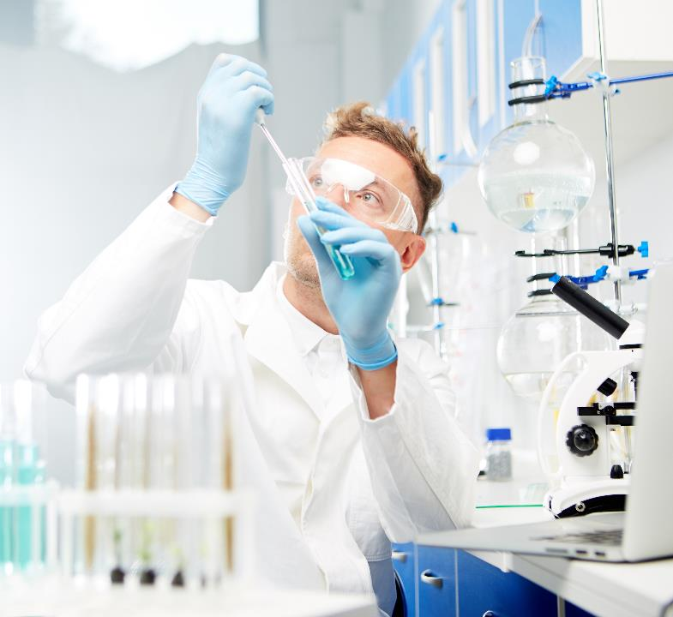
Q&A
Contact Us
Dr. Mahadeo Sukhai
Mahadeo.Sukhai@idea-stem.ca

